Slide 1


Malware Detection using Machine Learning
Phase 3
Nikhil Goparapu
Data 606 – Spring 2021
Instructor: Dr. Murat Guner

Slide 2
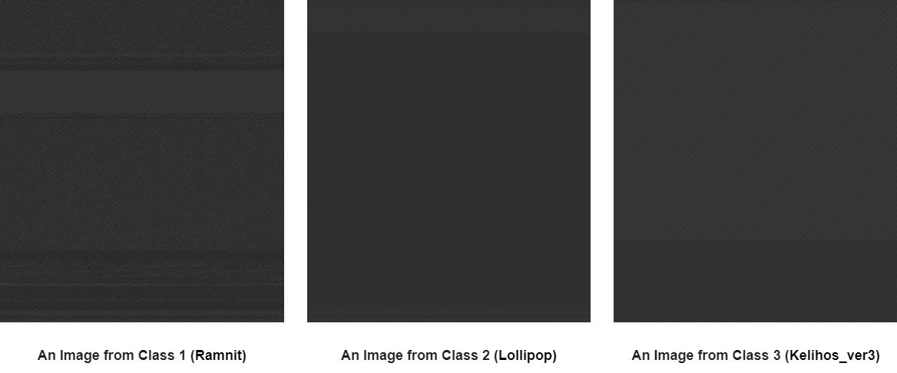
Feature Engineering: ASM Images
In the Phase 2, I have extracted images from asm files.
I’m using the top 800-pixel values of these images as features to my dataset.
These pixel values can be useful in classifying the family of the malware.
Notes:
Feature Engineering of ASM files.
I have extracted images from asm files, in phase 2. I’m using the top 800 pixel values of these images as features in my dataset.
These pixel values can very useful in classifying the family of the malware.

Slide 3

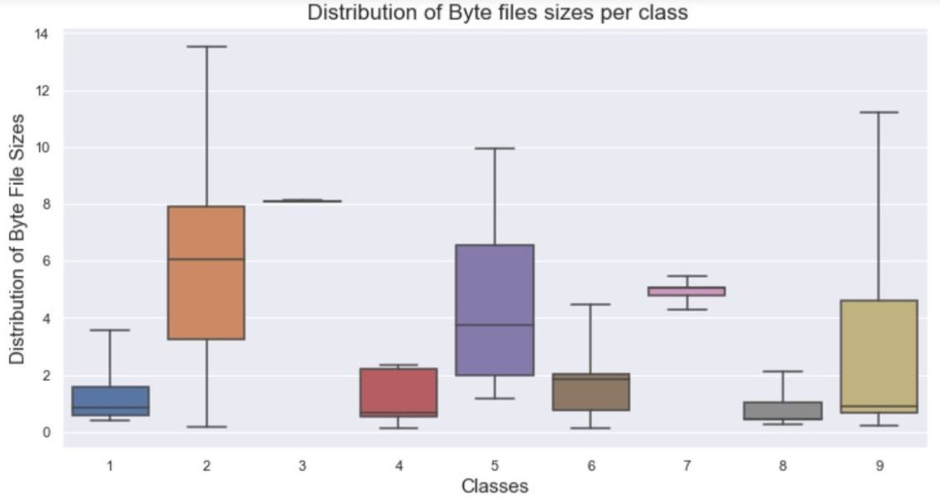
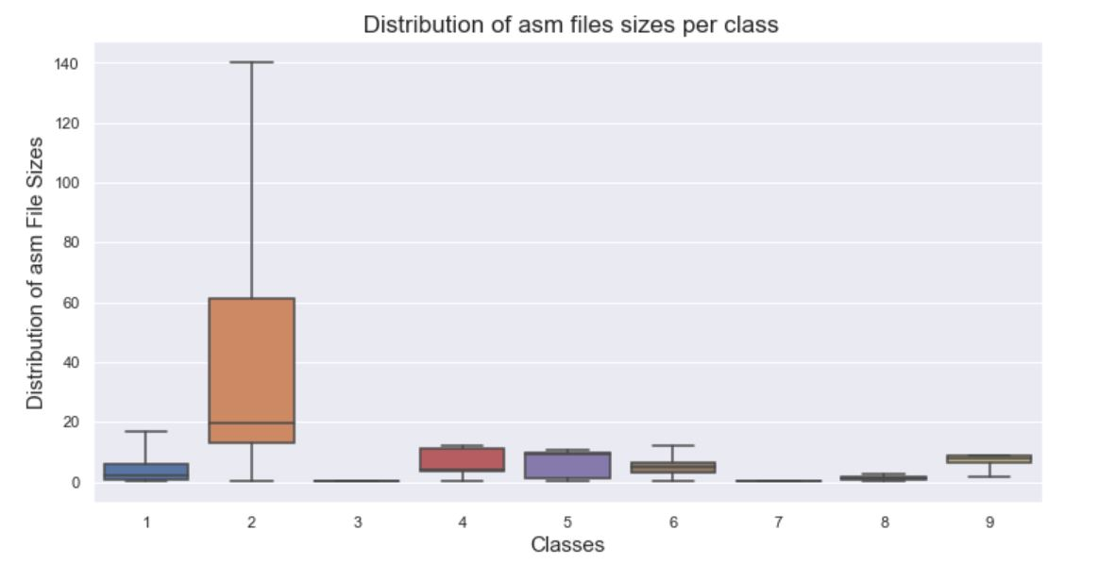
File size as features
In Phase 1, we have seen that the distribution of the file sizes for both byte files and asm files is not the same.
We can use the file sizes of both asm file and byte file as features.
Notes:
File size as features.
In phase 1, we used a boxplot to compare the distribution files files of both asm files and byte files.
To the right of this slide are the images of two box plots.
The figure on the top is the distribution files sizes of byte files.
The figure on the bottom is the distribution file sizes of asm files.
We can see that the distribution of the file sizes of both byte files and asm files is not same for all families of Malware.
Hence, the files sizes of both asm files and byte files can be useful feature in determining the family of the malware.

Slide 4

Final Preprocessed Dataset
After entire preprocessing, the final dataset consists of:
10,868 corresponding to each byte file.
1060 features. 256 unigram features, 800 asm images pixel value features, 1 missing value feature, and target variable which represents the class of the malware file.

Slide 5
Modeling
Training size: 80%
Test size: 20%
Model: XG Boost.
Sampling Technique: Stratified Sampling.
Hyperparameters:
Number of Trees: 800
Depth of each tree: 3
Notes:
I have used 80% of the data as training data and tested my model on remaining 20% of the data.
I have used XG Boost as my model.
Since the distribution of my dataset is not uniform, I have used stratified sampling to sample my dataset.
These are hyperparameters that I have used for my model. I have found then using grid search.
I have used 800 trees in my XG Boost model, with the depth of each tree being 3.

Slide 6
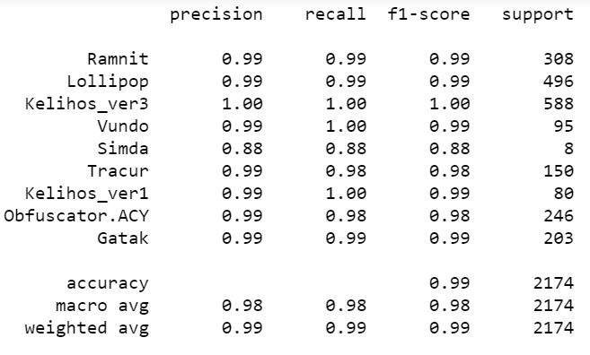
Results: Accuracy and Classification report
Classification Report
Accuracy on Training set: 100%
Accuracy on the Test set : 99.218%
Weighted Average F-1 Score on Test set : 0.99
Notes:
Now we shall discuss the performance of my model
My model did a pretty good job in detecting the Malware files.
The accuracy on the training set was 100% and the accuracy on the test set was 99.218%
The F-1 score is also pretty good.
The image on the right is the classification report of my model.
It shows how well did my model performed on classifying the malware files of each of the 9 classes of malware.

Slide 7
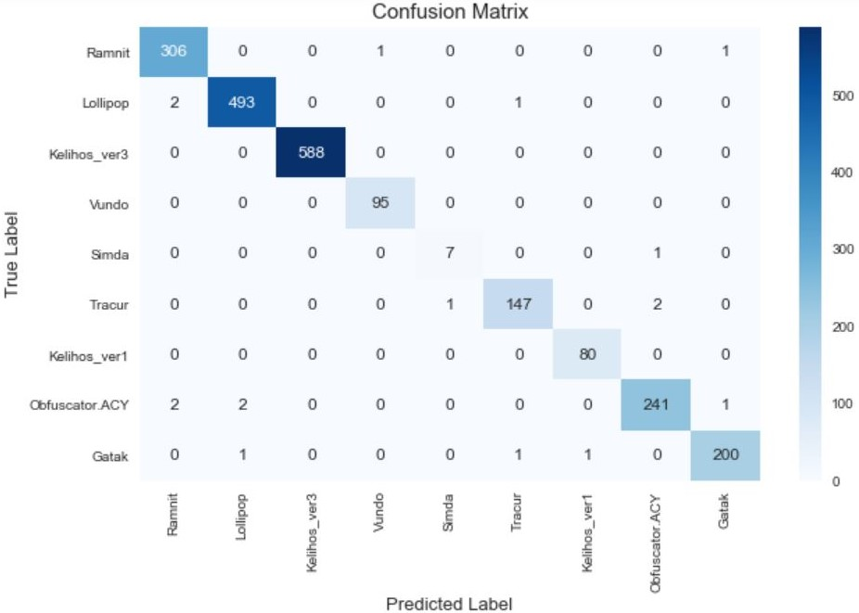
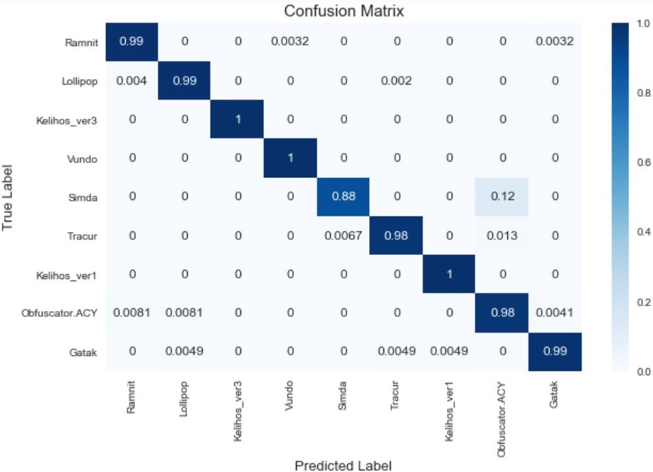
Results: Confusion Matrix
Confusion Matrix with actual number of instances
Confusion Matrix normalized
Notes:
Here is the confusion matrix on the test set
The image on the left is confusion matrix with actual number instances for each class and the image on the right is the normalized confusion matrix.
From the normalized confusion matrix, we can see that the model can detect all the classes with an accuracy around 99% except for 1 class. Which is the minority class

Slide 8
Limitation and future scope
Data is one of the main limitation.
We have access to the files of only 9 classes of Malware.
We can extend the model to more than the 9 above-mentioned classes once we have access to data.
Notes:
Data is one of the main limitation.
My model can only detect a malware file belonging only the above mentioned 9 families of Malware.
If we have access to the labelled data of the other families of Malware files, we can extend our model to detect malware files belonging to other families of malware.

